Slide 1
Module 4: Lesson 1 Spark Overview

Slide 2
Apache Spark
Apache Spark is a open source unified computing engine and a set of libraries for parallel data processing on computer clusters
It is one of the most popular frameworks for big data processing today
It was created at AMPLabs in UC Berkeley as part of Berkeley Data Analytics Stack
Spark can run on a Hadoop YARN cluster manager, and can read any existing Hadoop data among other data sources
Spark itself is written in the language Scala, and runs on the Java Virtual Machine (JVM)

Slide 3
Apache Spark
The success of Spark in the marketplace is widely attributed to to three primary characteristics
Its documented 10x to 100x reduction in processing time versus the MapReduce framework
Its improved usability resulting in Spark applications requiring 2x to 5x less code versus the MapReduce framework
It is designed to cover a wide range of workloads that previously needed separate distributed processing systems

Slide 4
Spark as a Distributed Processing Framework Scope of Applicability
Batch Data Processing
When the processing and analysis happens on a set of data that have already been stored over a period of time. For data science this is used to explore historical trends or stable patterns
Apache
MapReduce
An example would be the analysis of patterns of ice cream purchases in Chicago over a year to determine which months to stock up on certain flavors
Interactive Data Processing
A computing approach where users actively engage with a system, receiving near real-time responses fostering a responsive and iterative exchange between the user and the system
Apache
Spark
An example would be systems which support tasks such as interactive data exploration, analysis and visualization.
Streaming Data Processing
When data will be analyzed and actions will be taken on the data within a short period of time (near real-time). For data science this is used to make short term corrections and decisions
Examples would be credit card fraud detection or cloud account intrusion detection

Slide 5
Apache Spark
Spark supports multiple widely used programming languages (Python, Scala, Java, and R)
It can run anywhere from a laptop to a cluster of thousands of servers
This makes it an easy system to start with and scale up large volumes to data

Slide 6
Apache Spark
Spark is designed to support a range of data analytics tasks
All these forms of data handling can be done within the same application through a consistent and interoperable set of APIs
This main insight behind this capability is that real-world analytics tend to combine many differ categories of processing
Spark’s focus on speed, resilience, ease of use, and diverse functionality make it a compelling choice for a wide range of data-driven applications

Slide 7
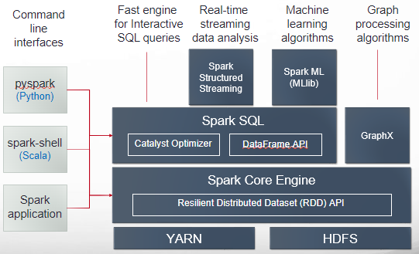
Apache Spark Conceptual Architecture
Spark Unifies
Interactive Processing
Application Processing
Batch Processing
Stream Processing
Machine Learning
Graph Processing
Unstructured Processing
Structured Processing

Slide 8
Apache Spark Key Characteristics
In-memory computing
Spark leverages in-memory data structures and caches, dramatically boosting processing speed compared to traditional disk-based data processing approaches like Hadoop. This empowers real-time analytics and interactive data exploration, ideal for time-sensitive applications.
Unified Platform
Spark provides a single framework for diverse data workloads, encompassing batch processing, streaming analysis, machine learning, and graph algorithms. This eliminates the need for separate tools and simplifies data processing pipelines, enhancing workflow efficiency.
Ease of Use
Spark boasts a rich library of pre-built functions and algorithms as readily available building blocks for constructing complex data processing pipelines. This modular approach minimizes the need for manual coding and debugging, compared to Hadoop's more code-intensive environment
Extensibility and Integration
Spark's design emphasizes extensibility, enabling integration with various data sources, storage systems, and libraries
Lazy Evaluation
Spark adopts a lazy evaluation strategy, postponing execution of data transformations until an output is required. This enhances optimization opportunities by allowing Spark to build an execution plan and then optimize it before initiating actual processing

Slide 9
Apache Spark and MapReduce
Aspect | Hadoop/MapReduce | Spark
Written In | Java | Scala
Performance | Fast | 10x-100x faster than MapReduce
Data Processing | Batch | Batch, Streaming, Interactive
Supported Languages | Java (other languages via Hadoop Streaming) | Java, Scala, Python, R
Working Sets | Working data stored on disk | Working data stored in memory
Iterations | Not well-suited for iterative algorithms | Caches intermediate data between iterations, making it more efficient for iterative algorithms
Ease of User | Requires proficiency in Java and MapReduce coding | Provides advanced data source parsing, and powerful data transformation functions

